Slide 1
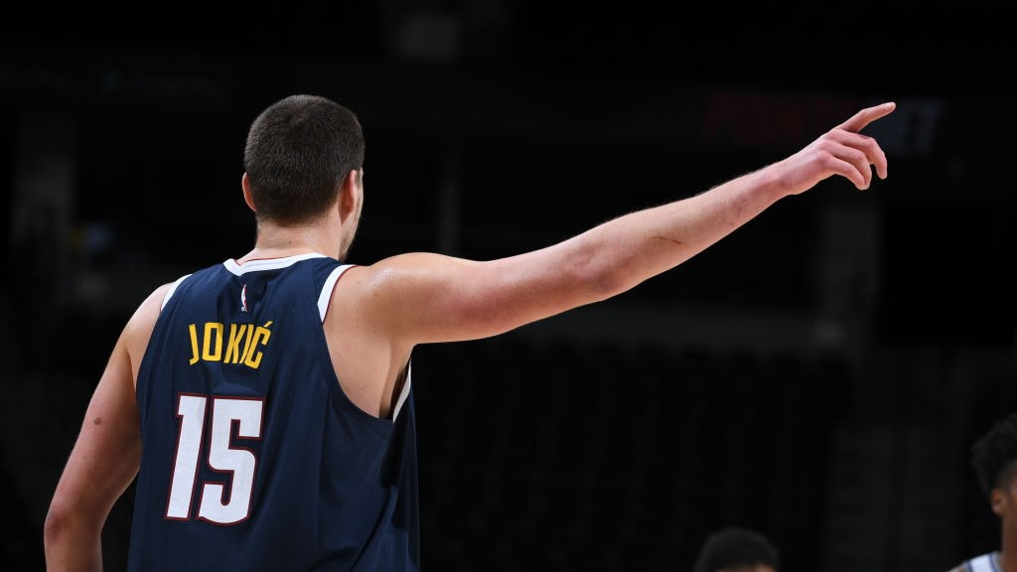
Classifying NBA Players
CS-UY 4563 Intro to Machine Learning
Rihui Zheng & Andrew Qu

Slide 2
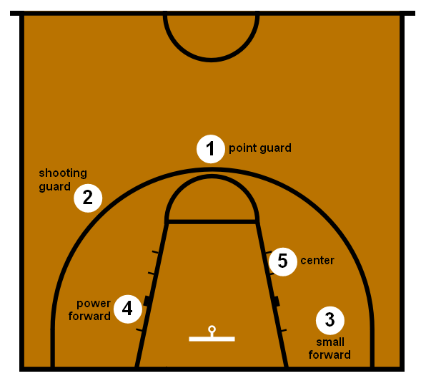
Problem Statement
Organized basketball has specialized positions
Suppose you know nothing about basketball and want to learn how positions are decided
Questions:
Is it possible to classify players into their positions? How accurate are the models?
Which model(s) gave the best accuracy?
How are the positions specialized?

Slide 3
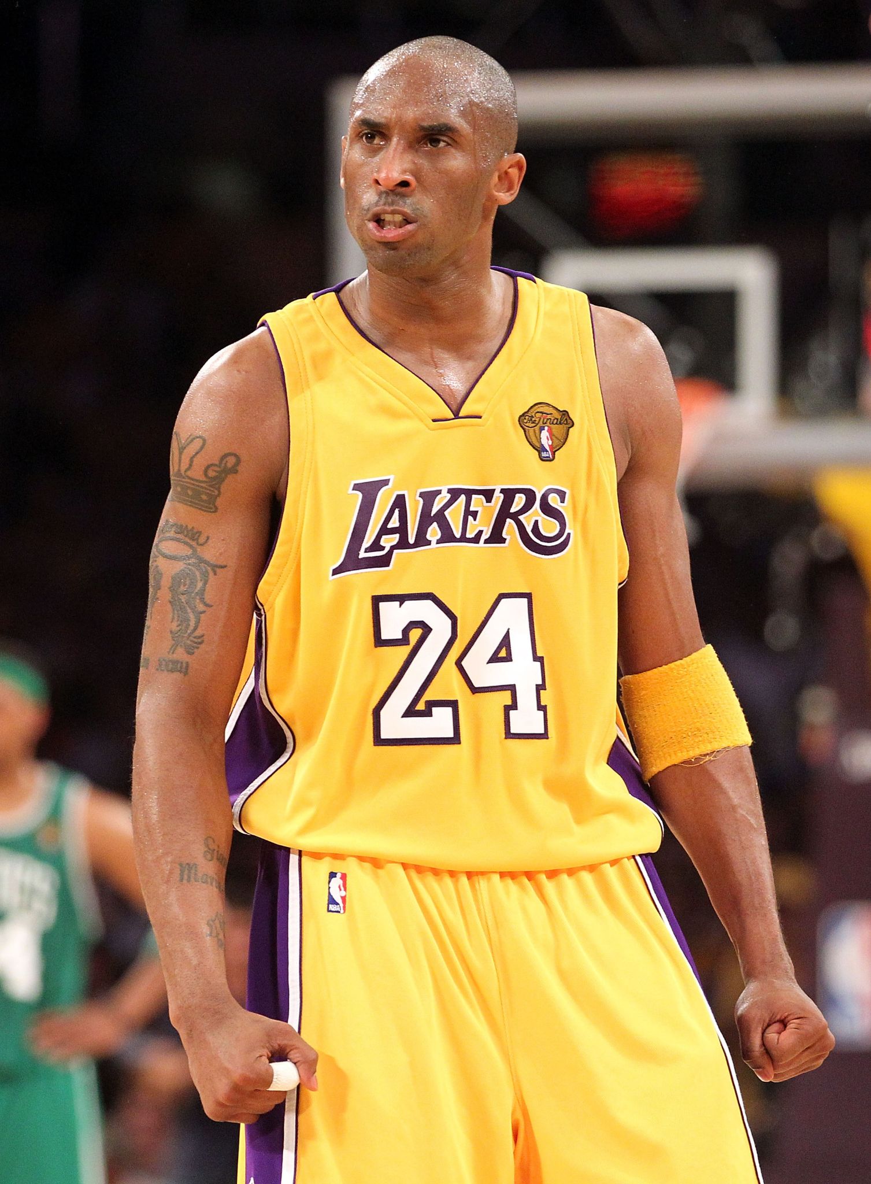
Dataset
kaggle.com/drgilermo/nba-players-stats
Season_Stats.csv
1950-2017
~25k rows, ~50 columns
Each row is defined by the player, year, and team (eg. Kobe’s 2010 season with the Lakers is one row)
Other columns are stats over the season (total points, FG%, 3PAr, TRB%, games played, etc.)
Label: Position (supervised learning)

Slide 4
Preprocessing
Target: ‘Pos’
Features
Drop non-numeric or irrelevant columns (name, team)
Drop players who did not play enough minutes
Drop “total” stats like PTS, TRB, or AST
Totals could just depend on minutes played
Drop sophisticated stats like WS, VORP, BPM
Left with: Age, TS%, 3PAr, TRB%, AST%, STL%, BLK%, USG%, FG%, 3P%, 2P%, FT%
Dropna() on rows (some stats were not recorded in the past)
Feature matrix shape: (5101, 13)
Position | Count
Center | 722
Power forward | 1010
Point guard | 1106
Shooting guard | 1133
Small forward | 1130

Slide 5
Preprocessing cont.
sklearn.preprocessing.StandardScaler
Train_test_split()
Two-thirds train, one-third test
Encode positions [C, PF, PG, SG, SF] as 0, 1, 2, 3, 4 (arbitrary)

Slide 6
Multiple Logistic Regression
penalty=’none’
Training accuracy: 0.7114
Testing accuracy: 0.7084
Weights
C: +Age, -3PAr, +TRB%, -AST%, -STL%, +BLK%, +FG%
PF: +Age, -TS%, +TRB%, -AST%, -STL%, +BLK%, +USG%
PG: -Age, +3PAr, -TRB%, +AST%, +STL%, -BLK%, -3P%, +FT%
SG: -Age, -TRB%, +STL%, -BLK%, +USG%, -FG%, +2P%
SF: +TS%, -3PAr, +TRB%, -AST%, +BLK%, -FG%, +3P%, +2P%

Slide 7
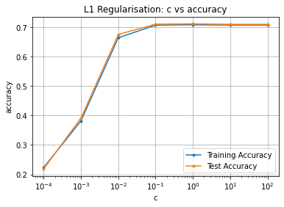
Multiple Logistic Regression cont.
penalty=’L1’
Training and testing accuracy are similar for all C
Best accuracy C =1
Training accuracy: 0.7088
Test accuracy: 0.7120

Slide 8
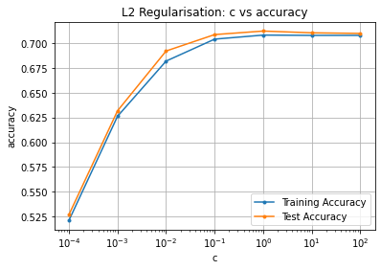
Multiple Logistic Regression cont.
penalty=’L2’
Training and testing accuracy are similar for all C
Best accuracy C = 1
Training accuracy: 0.7085
Test accuracy: 0.7126

Slide 9
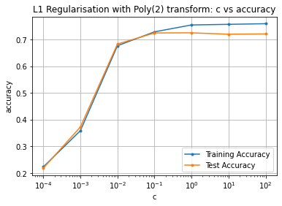
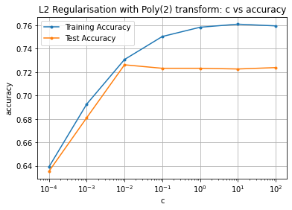
Multiple Logistic Regression cont.
Poly transform (d=2)
Penalty | Training Acc. | Testing Acc
None | 0.7583 | 0.7185
L1 | 0.7548 | 0.7251
L2 | 0.7597 | 0.7245

Slide 10
Support Vector Machines
Tried 3 Kernels: Linear, Polynomial, Radial Basis
sklearn.model_selection.GridSearchCV to test combinations of C and gamma
Linear:
C = [0.001, 0.01, 0.1, 1, 10, 100, 1000]
Poly + Rbf:
C: [1, 5, 10, 50]
gamma: [0.0001, 0.0005, 0.001, 0.005]
sklearn.metrics.classification_report to see performance for each position

Slide 11
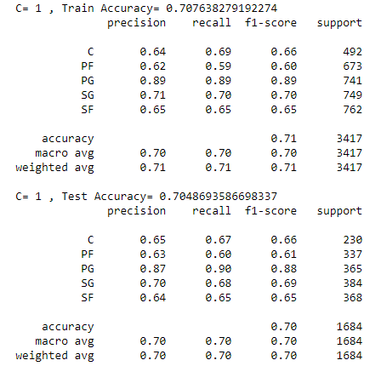
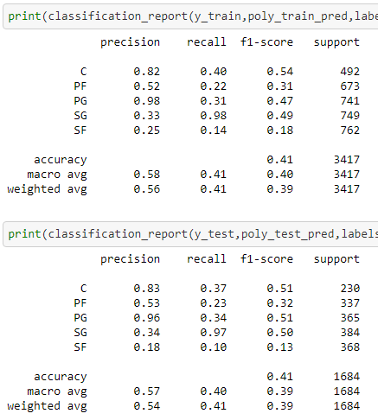
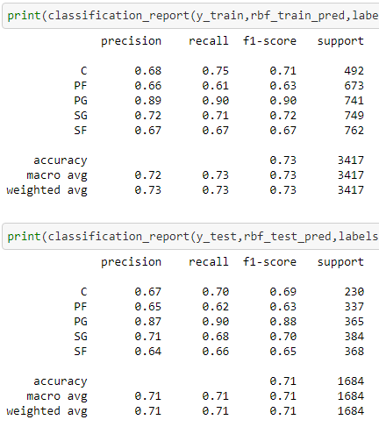
Support Vector Machines cont.
Observations:
PG accuracy best
C high precision, low recall
SG low precision, high recall
 | Linear | Polynomial | Radial Basis
Best Params | C=1 | C=50 gamma=0.005 | C=50 gamma=0.005

Slide 12
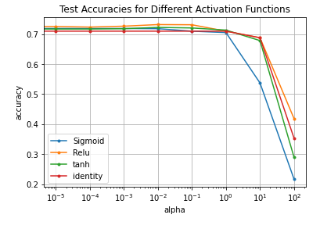
Neural Networks
Used sklearn's MLPClassifier class to make the model
parameter: alpha - L2 penalty parameter
Tested the accuracies of different activation functions with different alpha values:
1 hidden layer
50 nodes

Slide 13
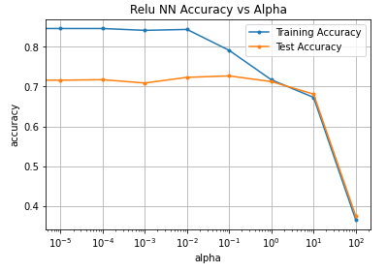
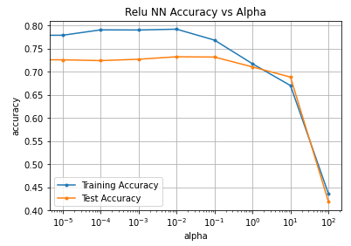
Neural Networks (cont.)
1 Hidden layer with size 100
Testing error vs. Training error for relu activation function
Trend is expected
Lower alpha = regularization has less impact
High variance evident, model was overfit
High alpha = large impact
High bias evident, model was underfit
More complex model = more parameters to train
More overfitting
1 Hidden layer with size 50

Slide 14
Neural Networks (cont.)
Testing different hidden layer sizes with different alpha values and different activation functions
Alpha values:
[0.1, 0.01, 0.001, 0.0001, 0.00001, 0]
Hidden layer sizes:
[(30),(30,30),(35),(40),(40,40),(45),(50),(50,30),(50,50),(55),(60),(65),(70)]
Best testing accuracy results:
Act Func Accuracy HL Sizes Alpha
Sigmoid: 72.8% (50, 30) 0.0001
Relu: 73.5% (35) 0.001
Tanh: 73.0% (55) 0.1
Identity: 71.7% (50, 50) 0.01

Slide 15
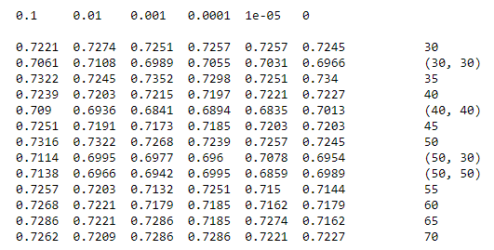
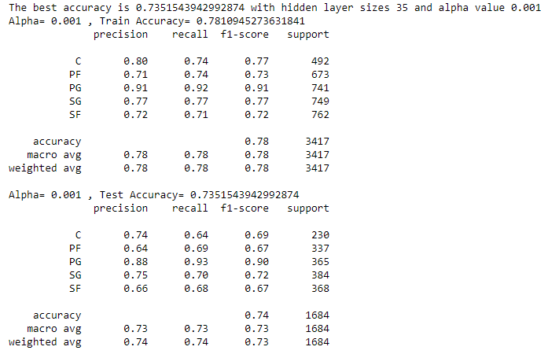
Neural Networks (cont.)
ReLU activation function test accuracy results:
Best test accuracy classification report:

Slide 16
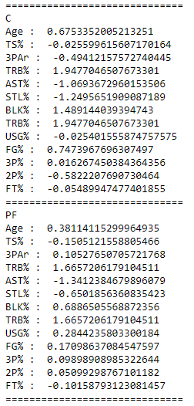
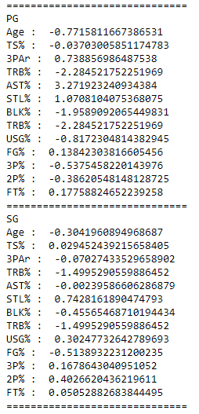
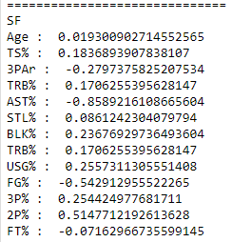
Findings/Conclusions
Some observations:
Age
Centers tend be older
Point guards tend to be younger
Assist%
Point guards tend to have higher AST%
True Rebound%
Shooting guards tend to have lower TRB%

Slide 17
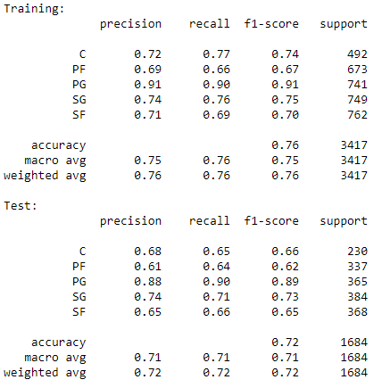
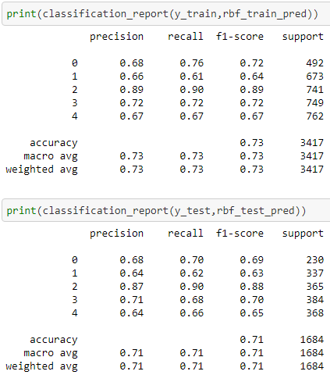
Findings/Conclusions (cont)
Classification reports for the best models:
Logistic Regression SVM Neural Network

